Slide 1
Comments on: “The Value of Precision in Geopolitical Forecasting” by Jeffrey Friedman, Joshua Baker, Barbara Mellers, Philip Tetlock and Richard Zeckhauser
Justin Wolfers
University of Michigan
also Brookings, CEPR, CESifo, IZA, PIIE and NBER
July 19, 2015; NBER Summer Institute — Economics of National Security

Slide 2
Why not give numerical assessments of probability?
Difficulty of quantification
But regular people can make fine-grained probability assessments
Uncertainty about these estimates is important
But uncertainty about probabilities is decision-irrelevant
Suggest overconfidence
But coarsening predictions does not solve overconfidence problem

Slide 3
The problem with words
When President John F. Kennedy asked the Joint Chiefs of Staff to assess the feasibility of the Bay of Pigs invasion:
“This plan has a fair chance of success”
Competing interpretations:
President Kennedy: This is an optimistic assessment
General David Gray: “We thought other people would think that ‘a fair chance’ would mean ‘not too good.’”
Would numbers have yielded clearer communication?

Slide 4

Are Fine-Grained Probability Estimates so Hard?

Slide 5

Are Fine-Grained Probability Estimates So Hard?

Slide 6
Why not give numerical assessments of probability?
Difficulty of quantification
But regular people can make fine-grained probability assessments
Uncertainty about these estimates is important
But uncertainty about probabilities is decision-irrelevant
Suggest overconfidence
But coarsening predictions does not solve overconfidence problem

Slide 7
How important is uncertainty about probabilities?
An example: Is Osama living in Abbottabad?
Estimates range from 35% to 95%
Obama asked whether these judgments “disguised uncertainty as opposed to actually providing you with more useful information.”
2004 Intelligence Reform and Terrorism Prevention Act:
Analysts must “properly caveat and express uncertainties or confidence in analytic judgments.”

Slide 8
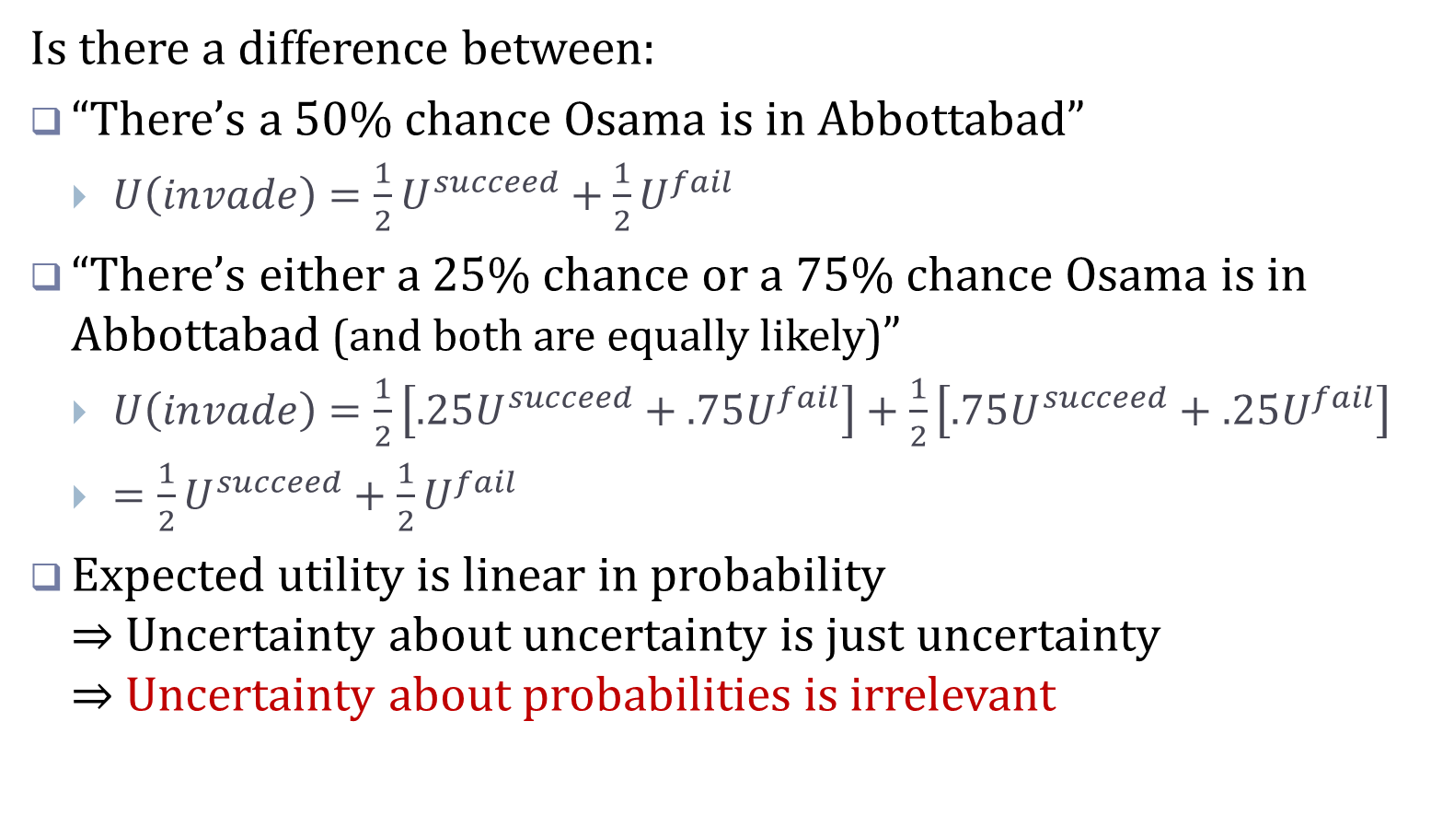
Uncertainty about probabilities is irrelevant
Is there a difference between:
“There’s a 50% chance Osama is in Abbottabad”
$U\left(invade\right)=\frac{1}{2}U^{succeed}+\frac{1}{2}U^{fail}$
“There’s either a 25% chance or a 75% chance Osama is in Abbottabad (and both are equally likely)”
$U\left(invade\right)=\frac{1}{2}\left[.25U^{succeed}+.75U^{fail}\right]+\frac{1}{2}\left[.75U^{succeed}+.25U^{fail}\right]$
$=\frac{1}{2}U^{succeed}+\frac{1}{2}U^{fail}$
Expected utility is linear in probability ⇒ Uncertainty about uncertainty is just uncertainty ⇒ Uncertainty about probabilities is irrelevant

Slide 9
Why not give numerical assessments of probability?
Difficulty of quantification
But regular people can make fine-grained probability assessments
Uncertainty about these estimates is important
But uncertainty about probabilities is decision-irrelevant
Suggest overconfidence
But coarsening predictions does not solve overconfidence problem

Slide 10
Probability weighting function
Underconfidence
Overconfidence

Slide 11
Optimal reporting: Inverse probability weights
Optimal reporting function
Correct Underconfidence
Correct overconfidence

Slide 12
How best to report probabilities?
Optimal reporting function
Report beliefs
truthfully
Intelligence Directive: Coarsen beliefs

Slide 13
Why not give numerical assessments of probability?
Difficulty of quantification
But regular people can make fine-grained probability assessments
Uncertainty about these estimates is important
But uncertainty about probabilities is decision-irrelevant
Suggest overconfidence
But coarsening predictions does not solve overconfidence problem

Slide 14
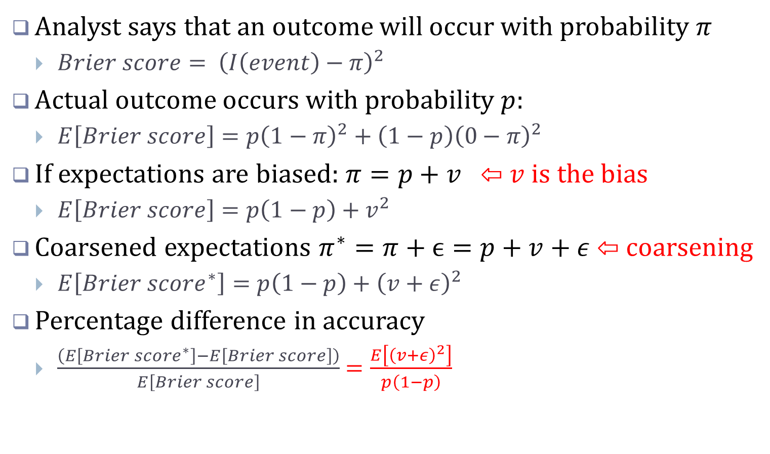
There is no need for empirical work
Analyst says that an outcome will occur with probability $π$
$Brier score= {\left(I\left(event\right)−π\right)}^{2}$
Actual outcome occurs with probability $p$:
$E\left[Brier score\right]=p{\left(1−π\right)}^{2}+\left(1−p\right){\left(0−π\right)}^{2}$
If expectations are biased: $π=p+v$ ⇦ $v$ is the bias
$E\left[Brier score\right]=p\left(1−p\right)+v^{2}$
Coarsened expectations $π^{∗}=π+ϵ=p+v+ε$ ⇦ coarsening
$E\left[Brier score^{∗}\right]=p\left(1−p\right)+{\left(v+ε\right)}^{2}$
Percentage difference in accuracy
$\frac{\left(E\left[Brier score^{∗}\right]−E\left[Brier score\right]\right)}{E\left[Brier score\right]}$ $=\frac{E\left[{\left(v+ε\right)}^{2}\right]}{p\left(1−p\right)}$

Slide 15
Why not give numerical assessments of probability?
Difficulty of quantification
But regular people can make fine-grained probability assessments
Uncertainty about these estimates is important
But uncertainty about probabilities is decision-irrelevant
Suggest overconfidence
But coarsening predictions does not solve overconfidence problem

